Slide 1


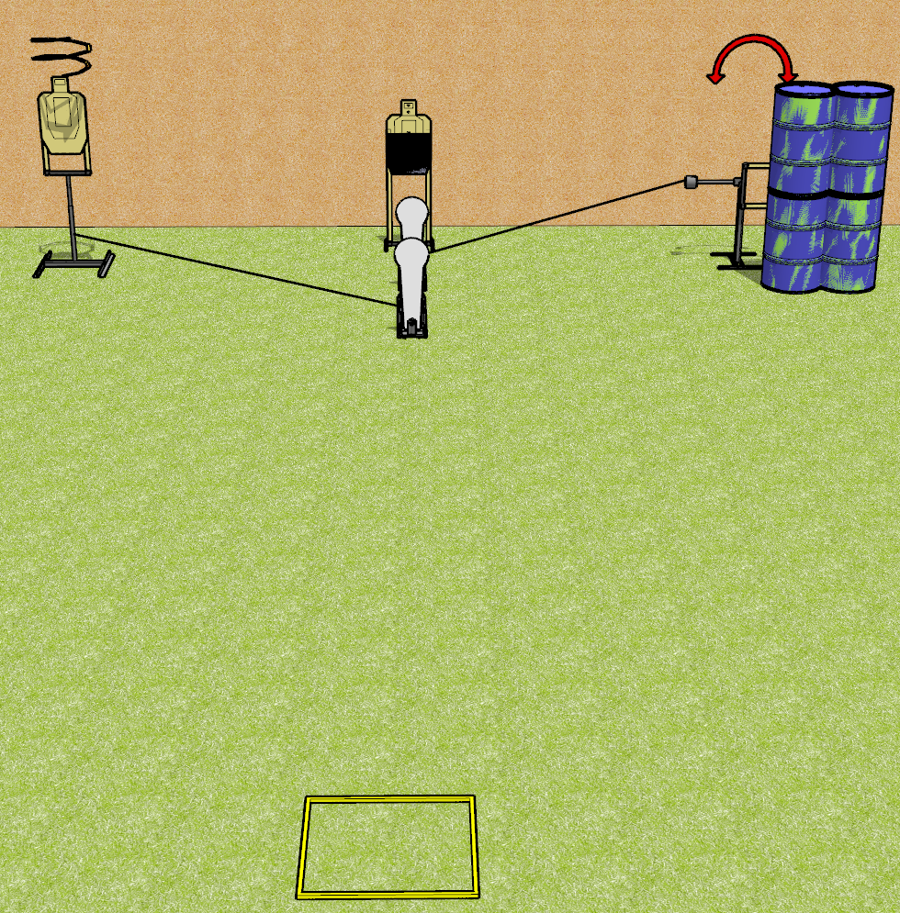
 | Dothan Gun Club – USPSA Match Lag Time Course Designer : Drew Coleman
Round Count 8 rounds 3 USPSA targets 2 colt poppers
Equipment List Drop turner, swinger, 2 activators Shooting box 1 50% hard cover

Slide 2
Lag Time
Written Stage Briefing
Lag Time is an 8 round, 40 point, Comstock course of fire. There are 3 USPSA targets and 2 colt poppers. The best 2 hits on paper will score, and steel must fall to score. The start signal is audible.
The front colt popper activates the drop turner. The drop turner is a disappearing target. The rear colt popper activates the swinger, which remains visible at rest.
Handgun start position is toes against the back of the shooting area, facing up range, wrists above respective shoulders. Handgun is loaded and holstered.
PCC start position is heels against the back of the shooting area, stock on belt. Loaded carbine is held with both hands, safety on.
On start signal, engage targets as they become available from within the shooting area.

